Slide 1
NICE: Neurogenesis Inspired Contextual Encoding for Replay-free Class Incremental Learning
A20586593 Seonghwan Lim

Slide 2
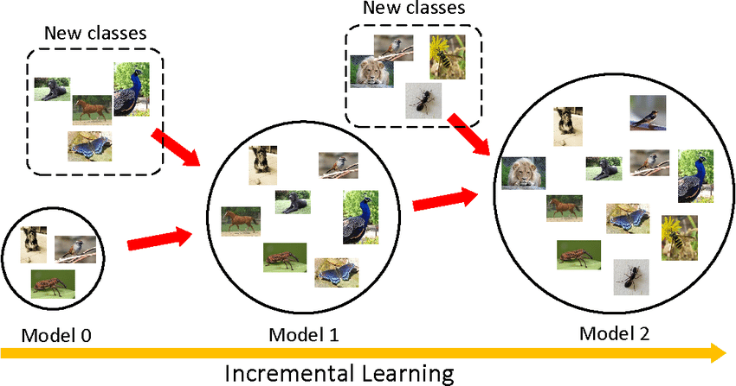
Class Incremental Learning

Slide 3
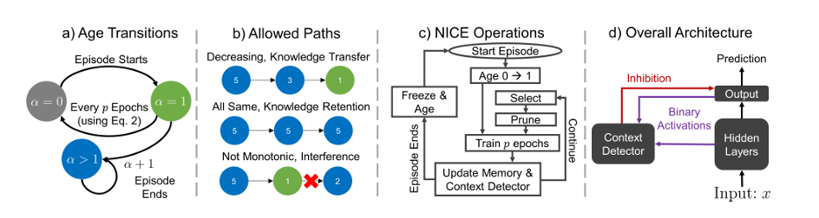
NICE: Neurogenesis Inspired Contextual Encoding for Replay-free Class Incremental Learning

Slide 4
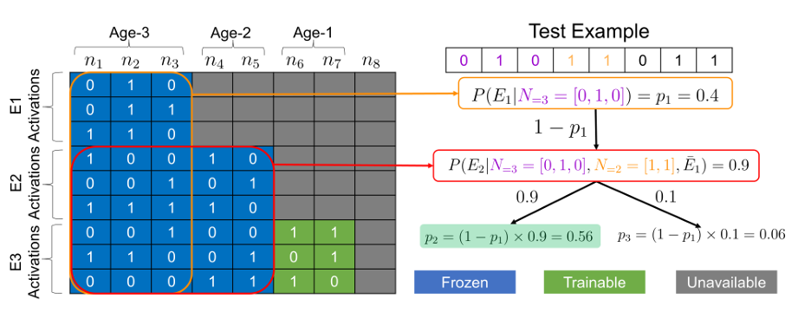
NICE: Neurogenesis Inspired Contextual Encoding for Replay-free Class Incremental Learning

Slide 5
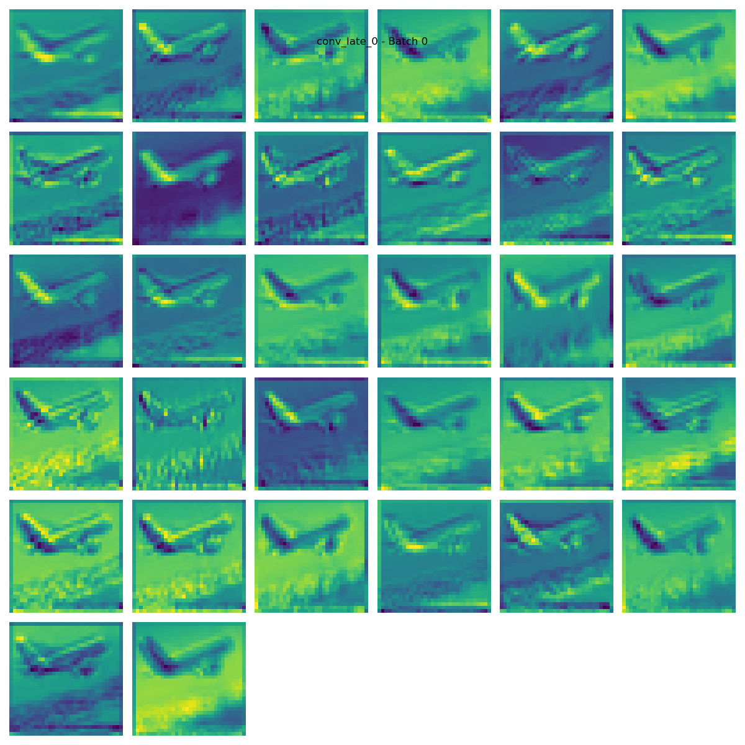
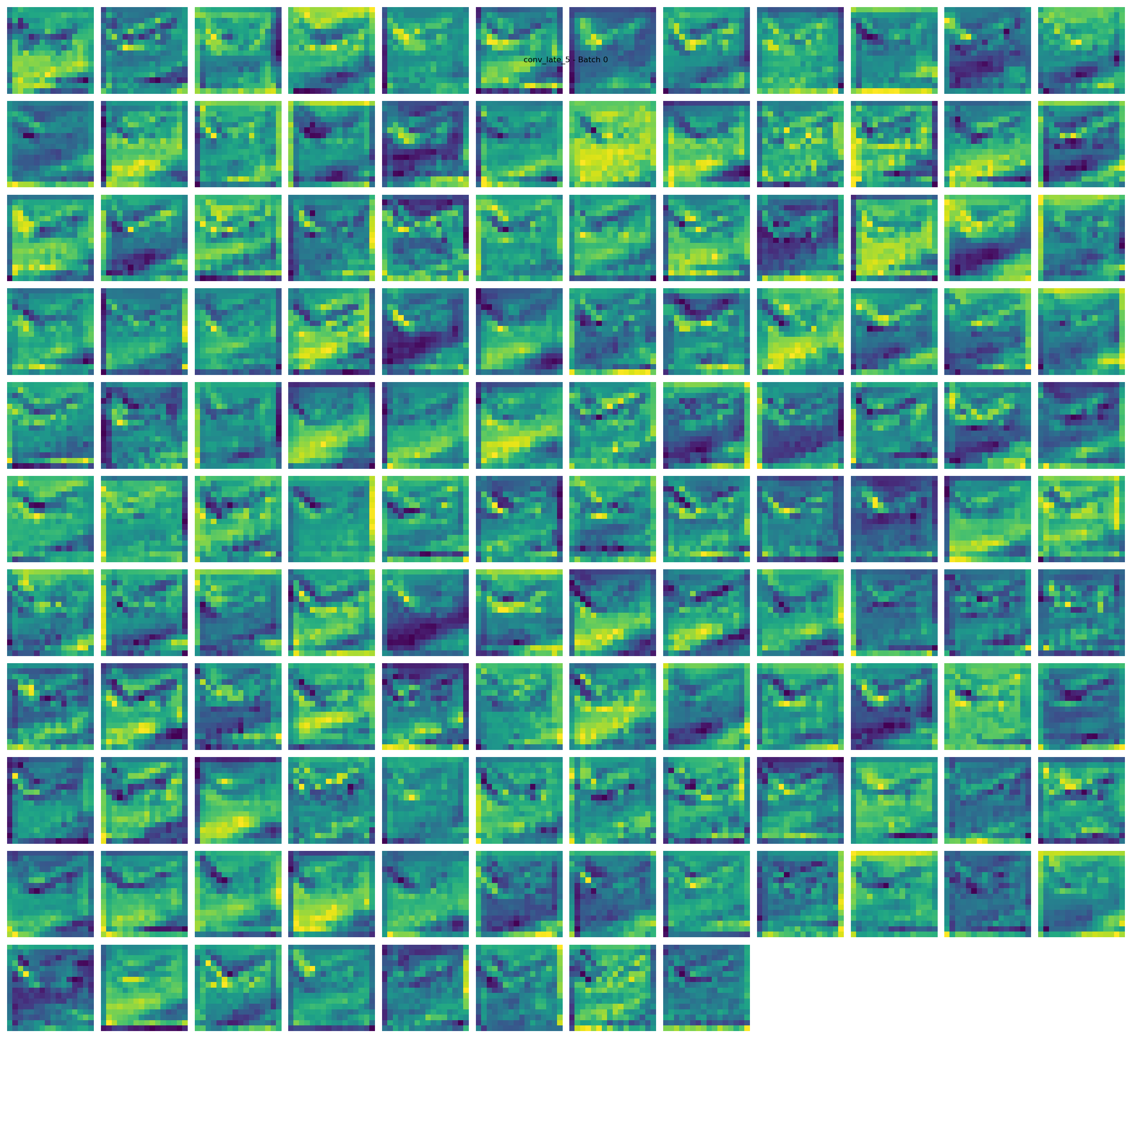
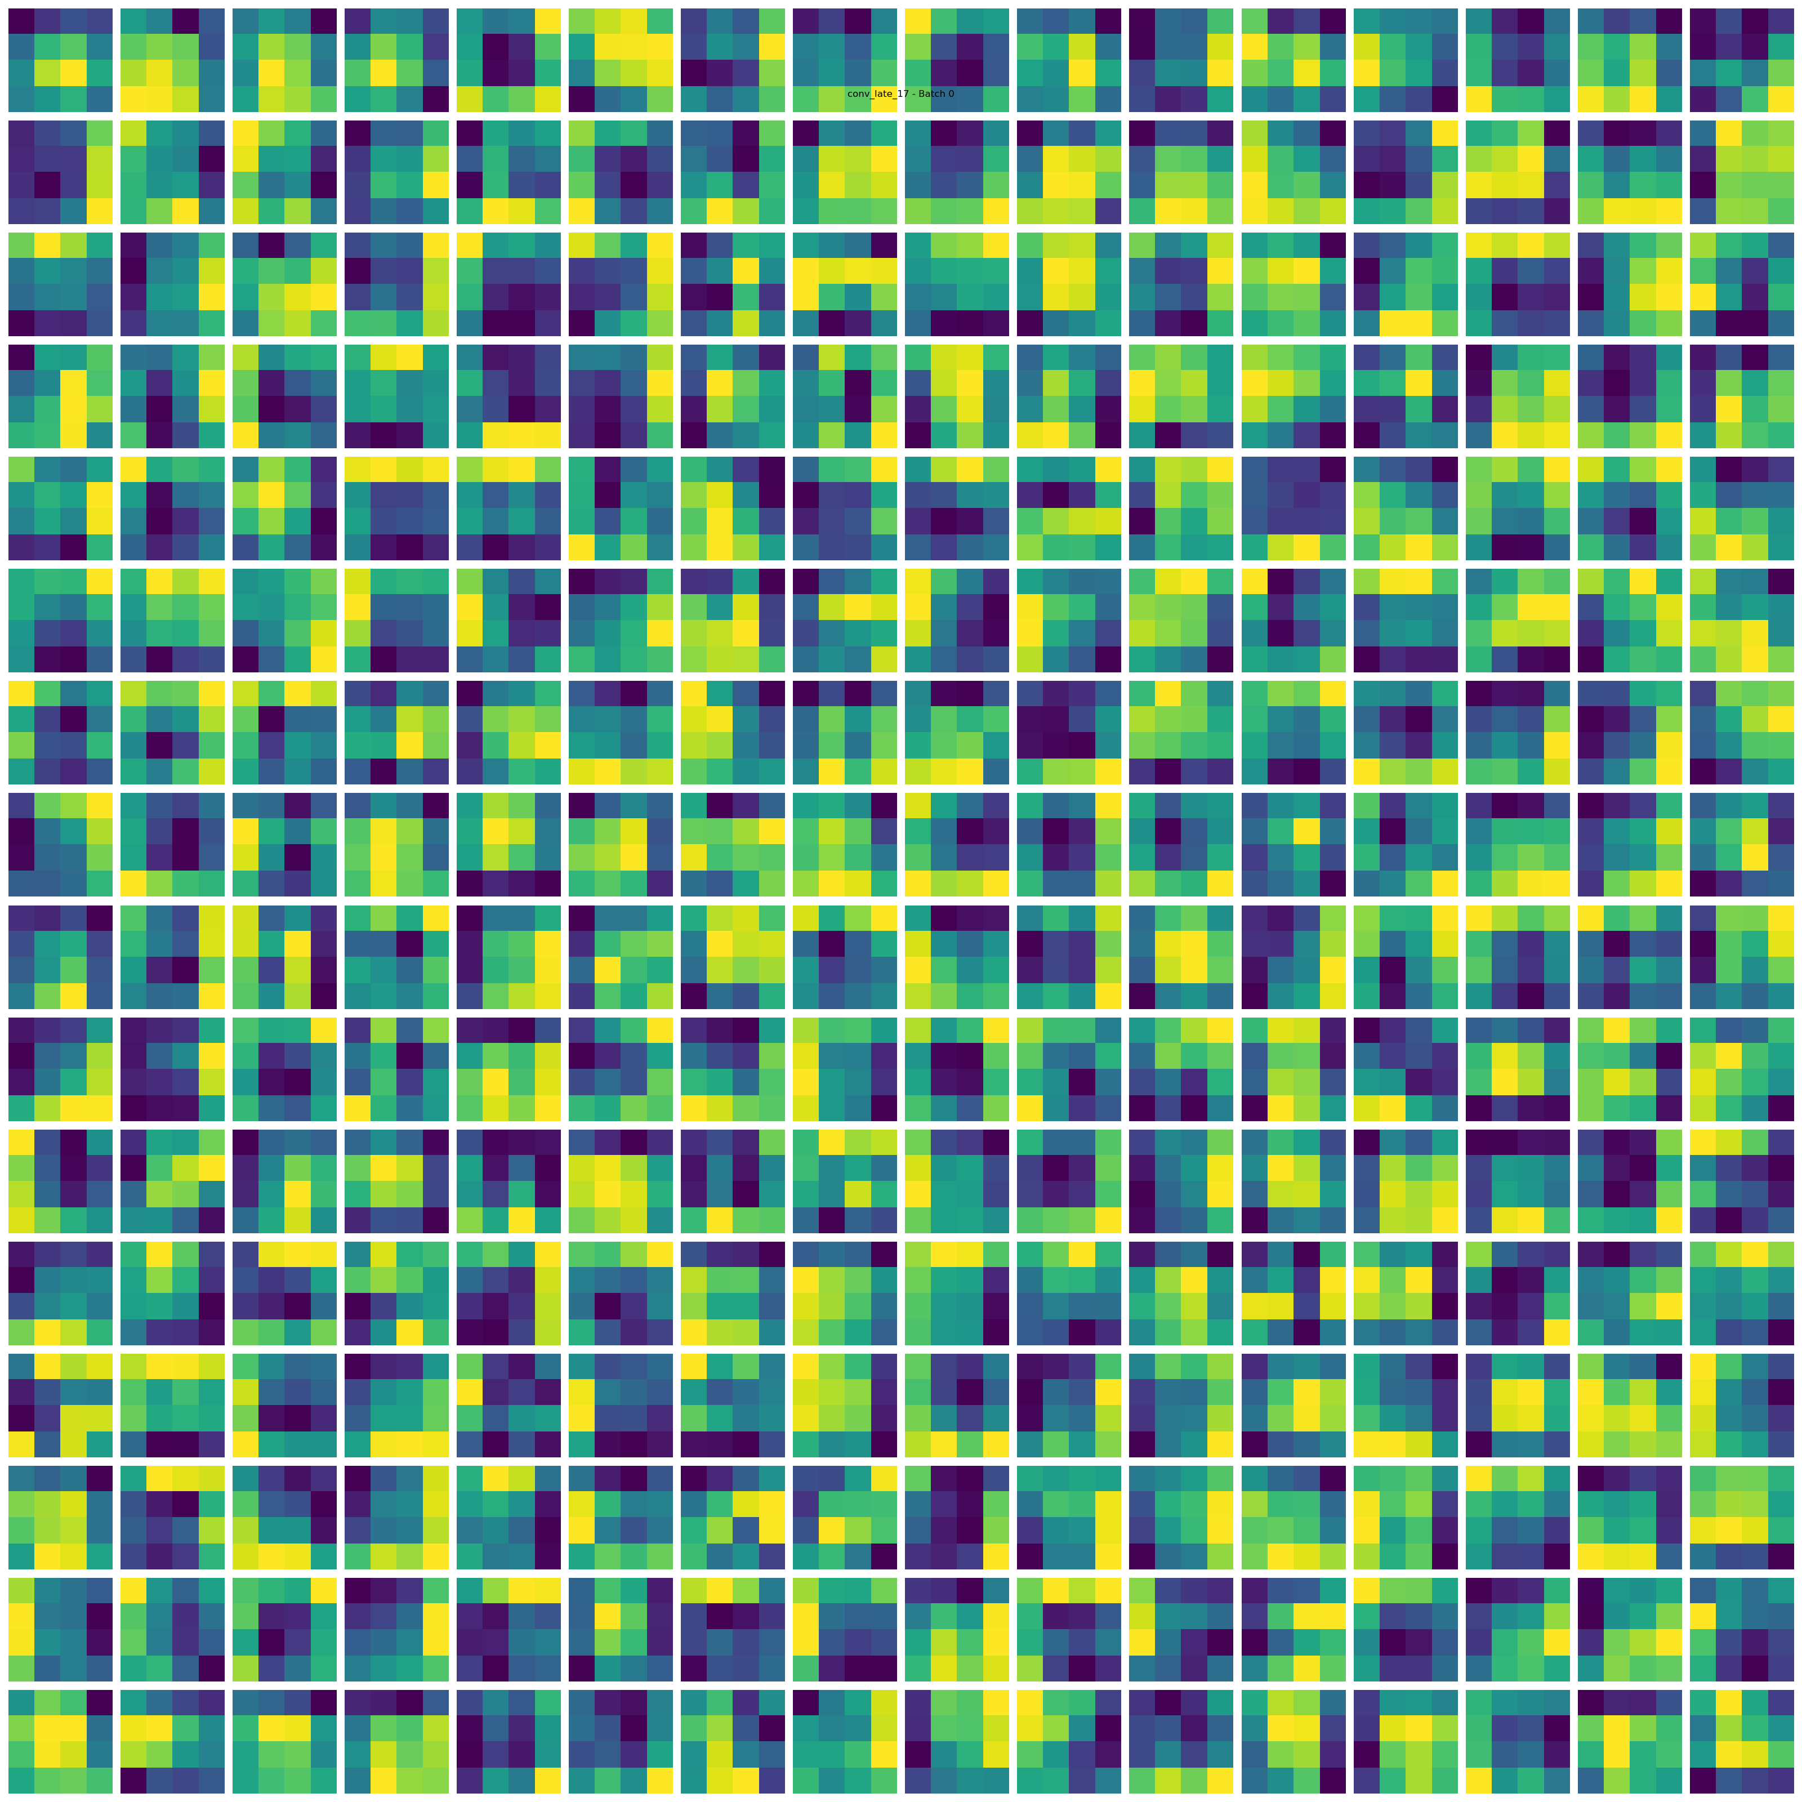
NICE: Neurogenesis Inspired Contextual Encoding for Replay-free Class Incremental Learning

Slide 6
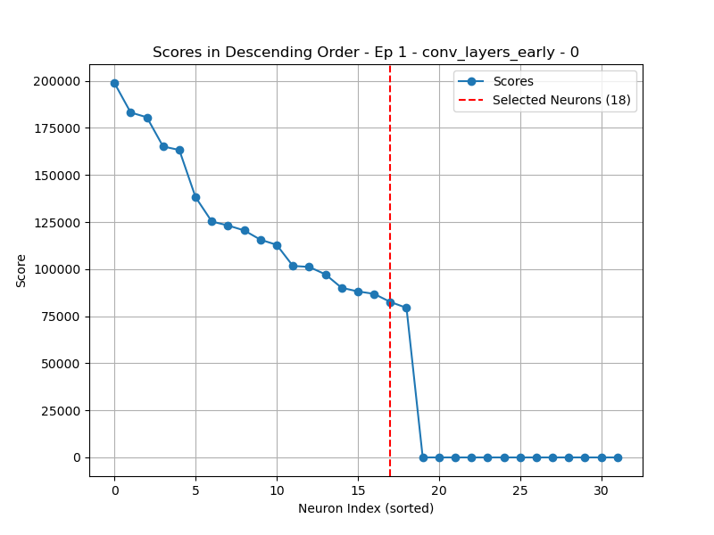
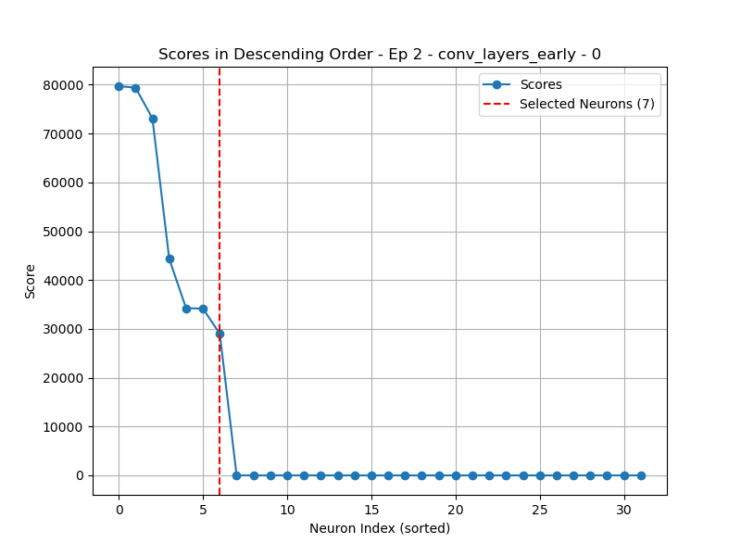
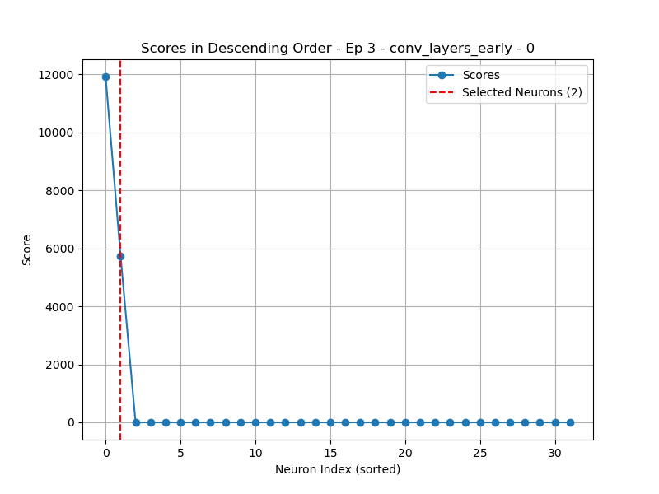
NICE: Neurogenesis Inspired Contextual Encoding for Replay-free Class Incremental Learning

Slide 7
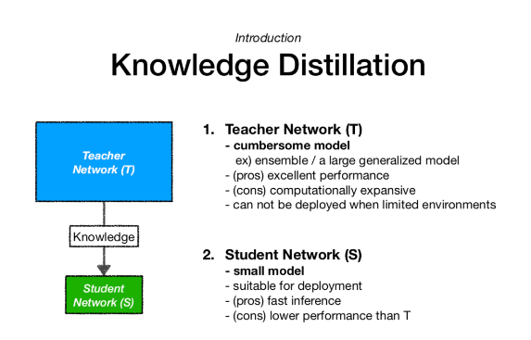
Knowledge Distillation

Slide 8
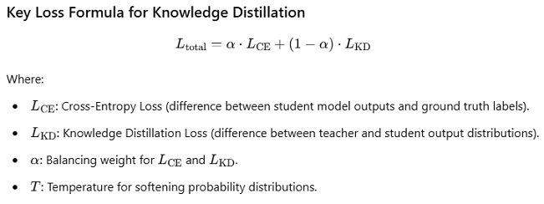
Knowledge Distillation

Slide 9
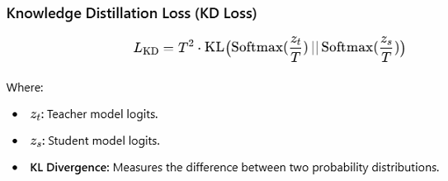
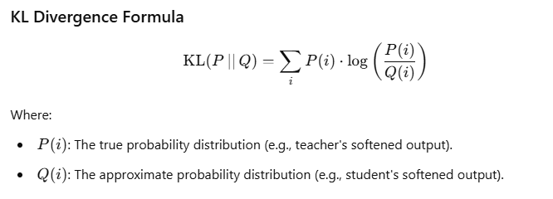
Knowledge Distillation

Slide 10
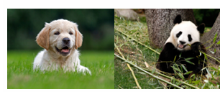

















Knowledge Distillation
$$Trained by Episode N−1$$
$$Layer 1$$
$$Layer 2$$
$$Layer 3$$
$$Layer 4$$
$$Output$$
$$Episode N$$
$$Trainable Episode N$$
$$Layer 1$$
$$Layer 2$$
$$Layer 3$$
$$Layer 4$$
$$Output$$
$$Layer 1KD Loss$$
$$Layer 2 KD Loss$$
$$Layer 3 KD Loss$$
$$∑$$
$$Total KD Loss$$

Slide 11
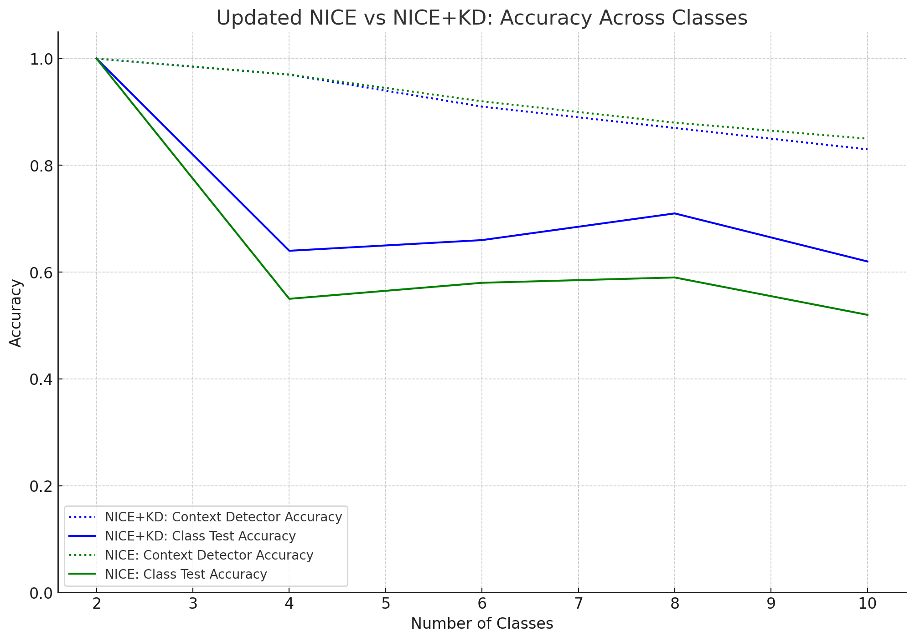
Knowledge Distillation
Model: CNN_MNIST
Data: MNIST

Slide 12
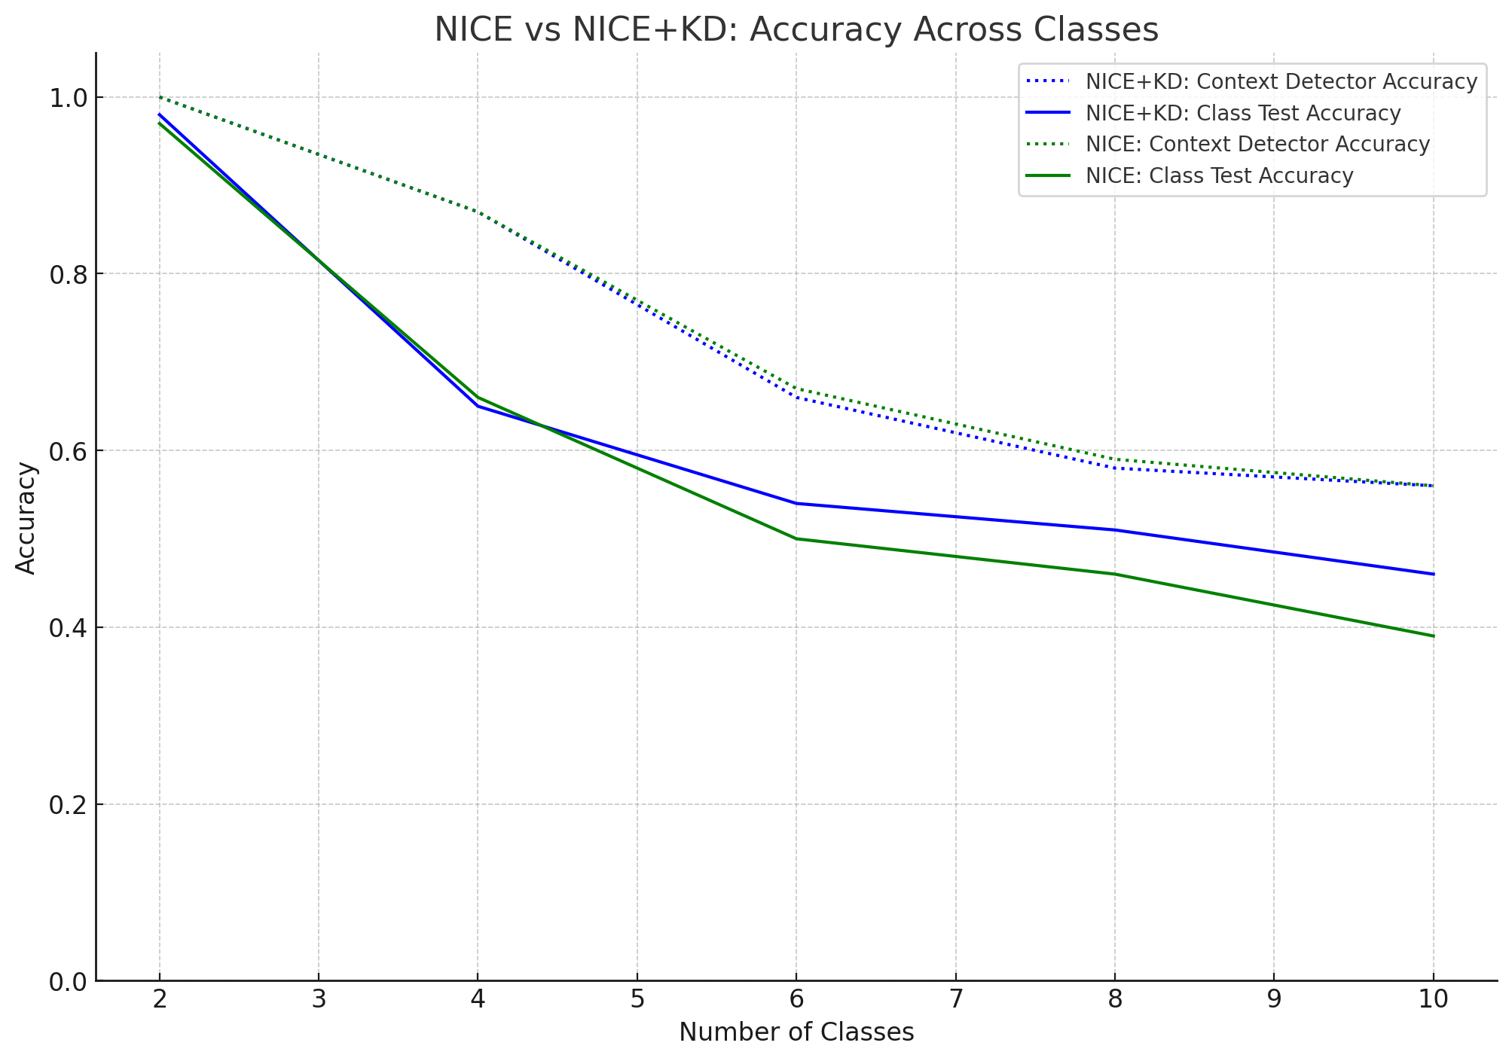
Knowledge Distillation
Model: VGG11 SLIM
Data: CIFAR10

Slide 13
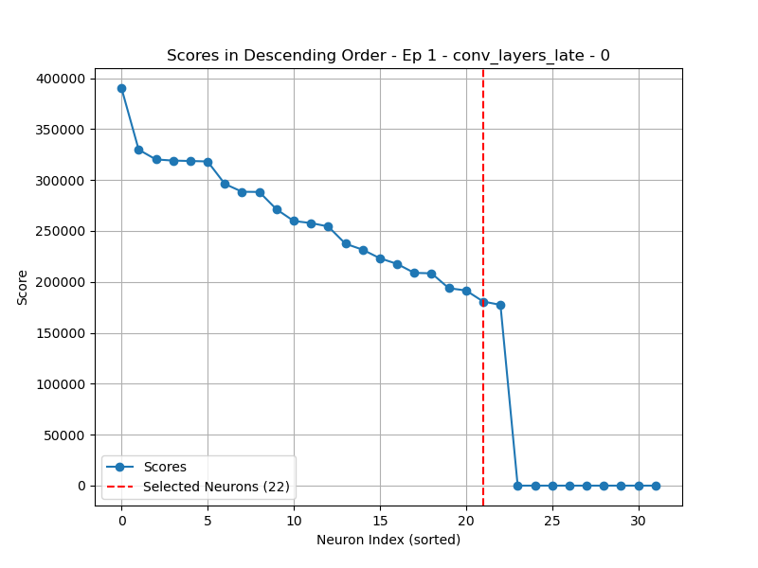
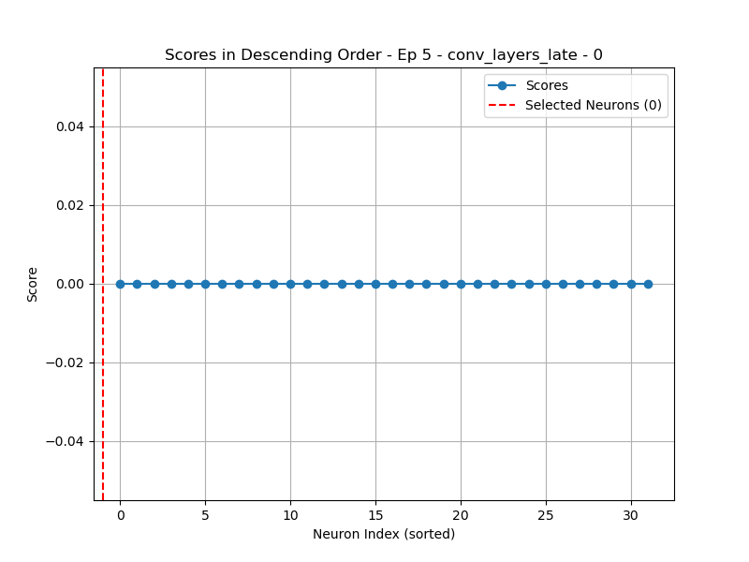
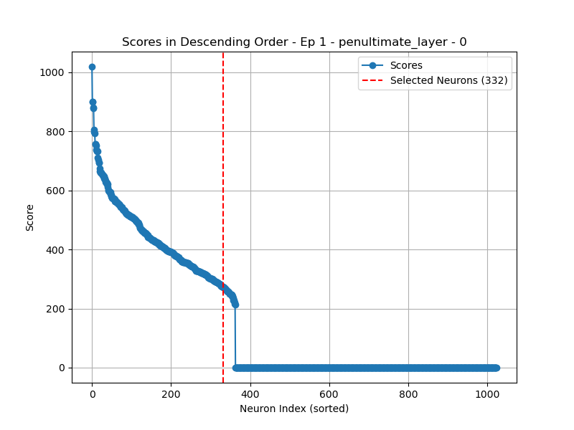
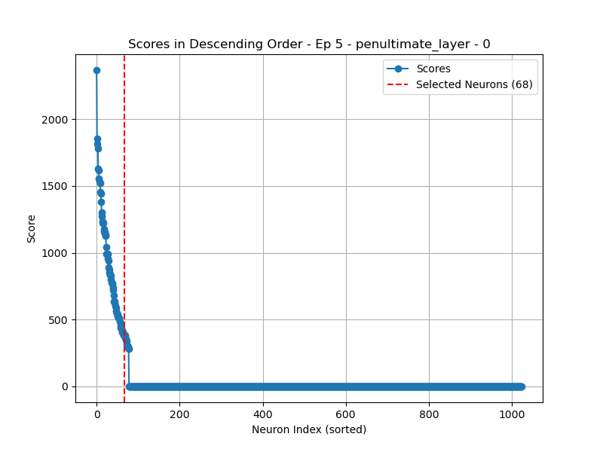
Future Works

Slide 14
Future Works

Slide 15
Question

Slide 16
Thank You

